Slide 1
Welcome to Azure Defender + Azure Sentinel Better Together! Day 1

Slide 2
A look into Day 1
Kick-Off | 8:00-8:05 | Welcome | Main Call
 | 8:05-8:30 | Security Center + Azure Defender
 | 8:30-8:45 | Demo Walkthrough
Ingest | 8:45-9:00 | Break
 | 9:00-10:00 | Azure Security Center
 | 10:00-11:00 | Activity: Azure Defender | Table Group Call
 | 11:00-11:15 | Break
 | 11:15-12:00 | Build Hands-on: Azure Defender Part 1 | Table Group Call
Transform | 12:00-1:00 | Break | Main Call
 | 1:00-1:30 | Azure Defender Solutions
 | 1:30-2:00 | Activity: Azure Defender
 | 2:00-3:00 | Build Hands-on: Azure Defender Part 2 | Table Group Call
 | 3:00-:15 | Closing | Main Call
Today we will be learning and collaborating across three spaces:
Main call (this meeting)
Table Group channel within the event Team
CloudLabs Learner Portal & Lab environment
Presentation/
Whole Group
Lab
Activity/ Discussion/ Group Work
Announcements

Slide 3
Pre-requisites
AZ-500 - Microsoft Azure Security Technologies
https://query.prod.cms.rt.microsoft.com/cms/api/am/binary/RE3VC70
SC-200 - Microsoft Security Operations Analyst
https://query.prod.cms.rt.microsoft.com/cms/api/am/binary/RE4Myp3

Slide 4
Security Center + Azure Defender

Slide 5
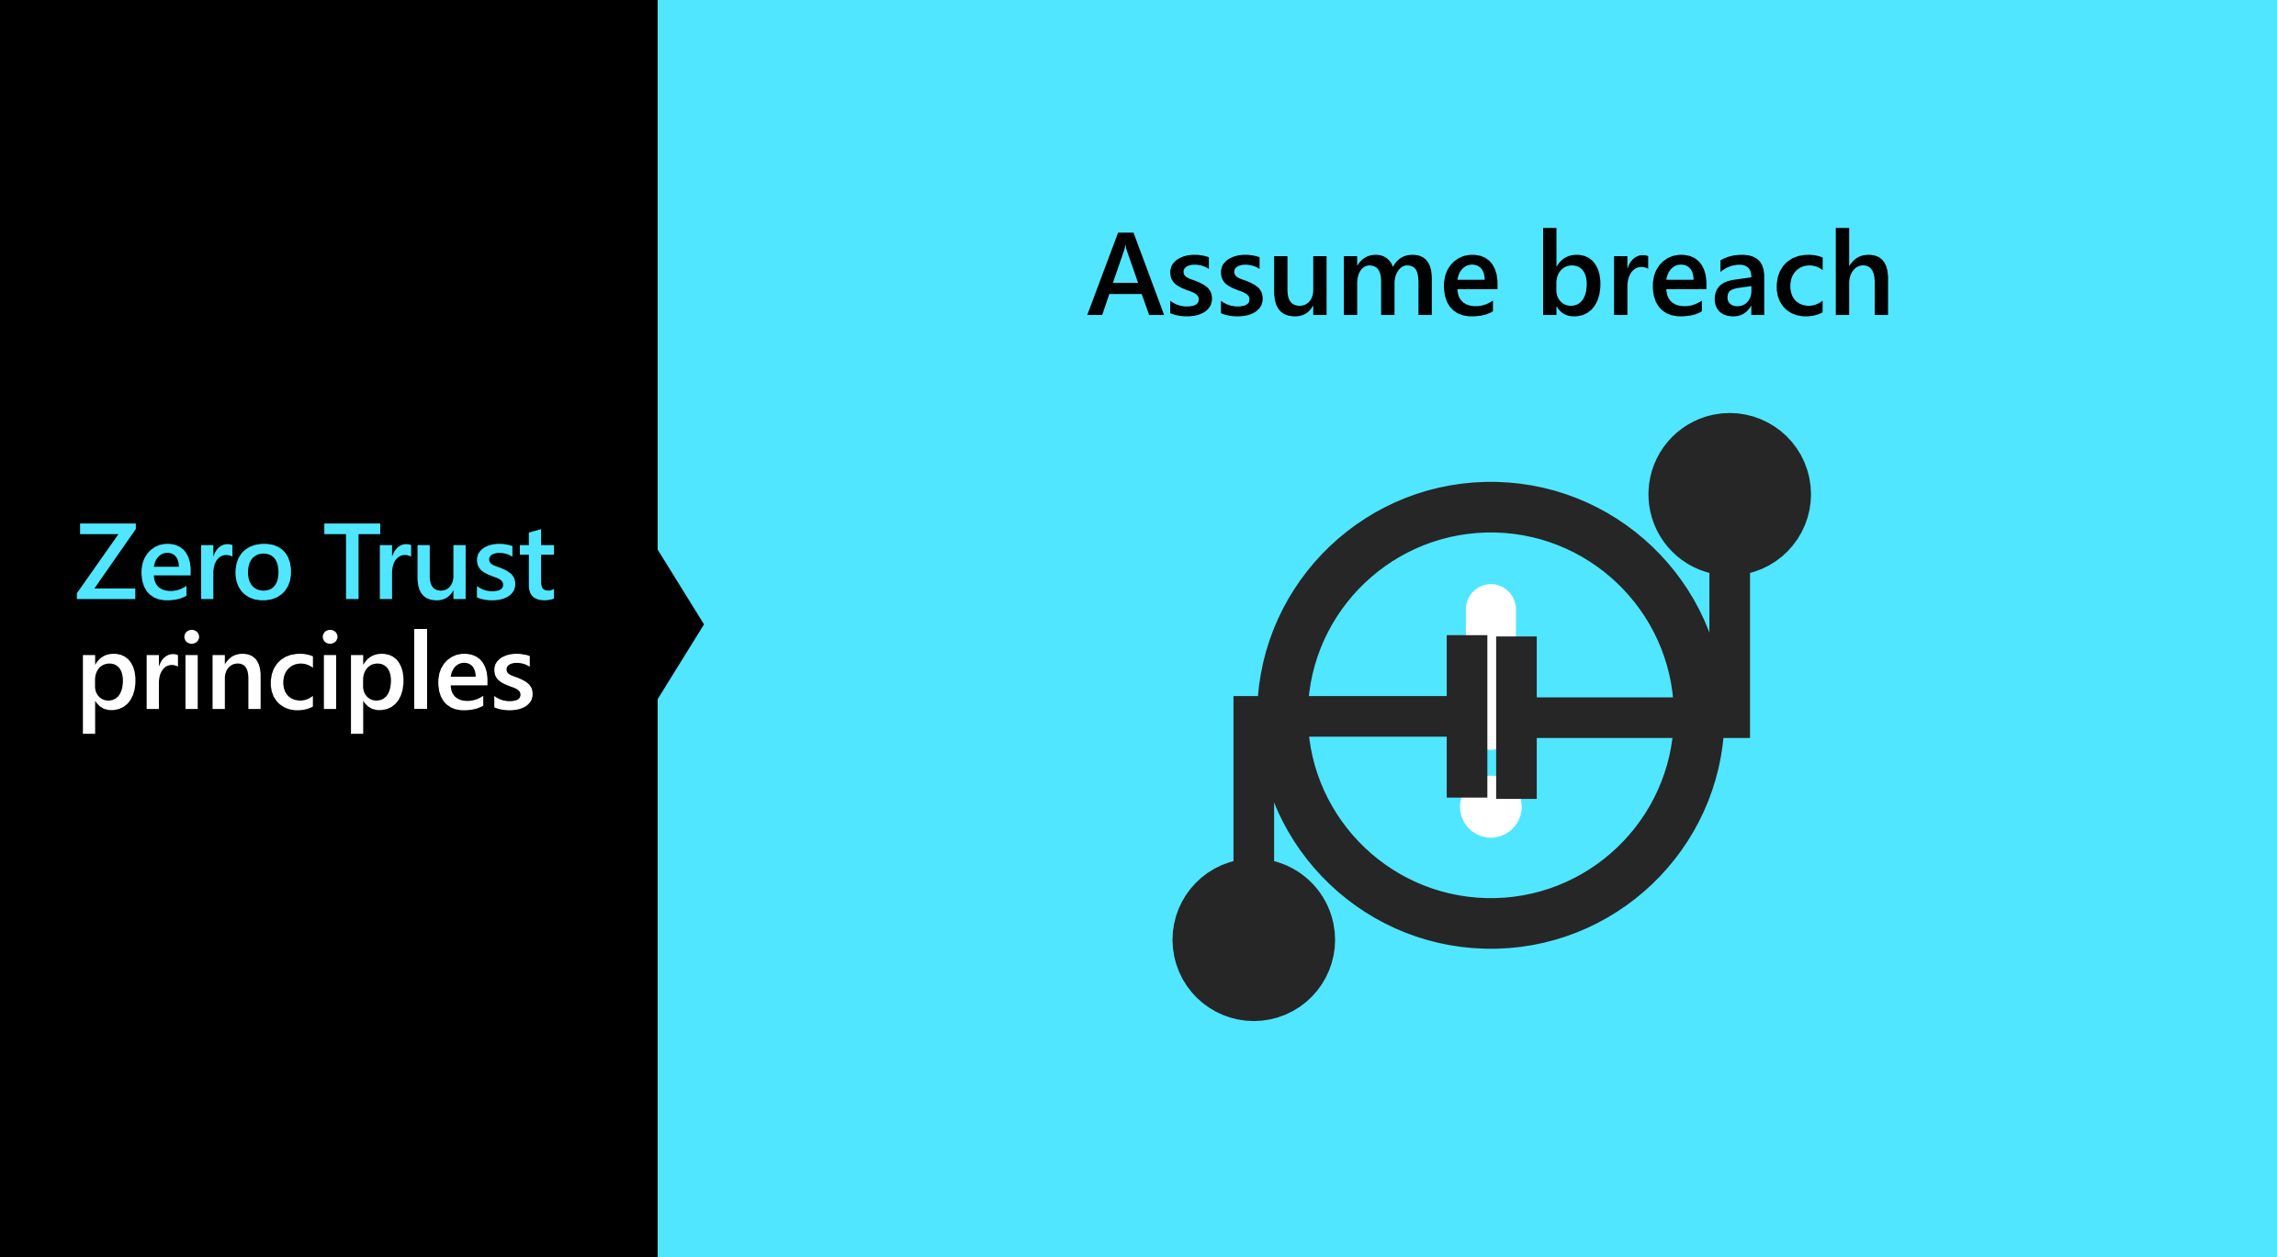

Slide 6

Zero Trust Principles
Verify Explicitly
Use Least Privileged Access
Assume Breach

Slide 7
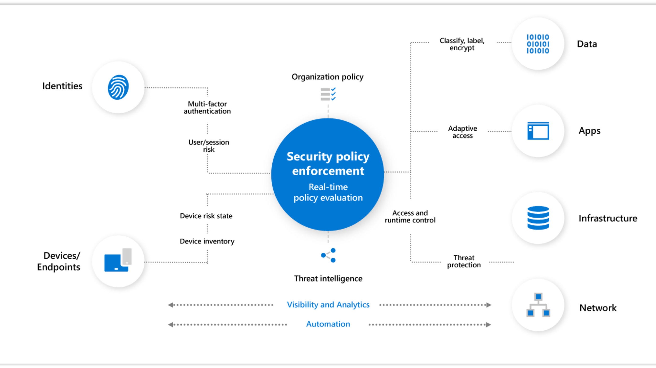

Slide 8

Why Assume Zero Trust?
Mobile Access
Cloud Migration
Risk Mitigation

Slide 9
Common Threats – Data Breaches
Access by an unauthorized 3rd party
Deliberate or accidental action by a controller or processor
Sending personal data to an incorrect recipient
Computing devices containing personal data being lost or stolen
Alteration of personal data without permission
Loss of availability of personal data

Slide 10
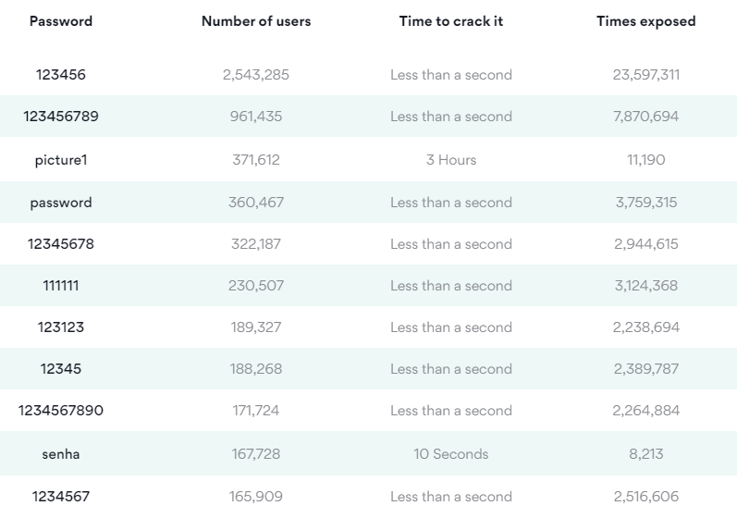
Common Threats – Choice of Passwords

Slide 11
Common Threats - Ransomware
Usually locks screen
Threatens with false accusations in harvesting illegal content
Requires some form of payment to gain access back to your data.

Slide 12
Common Threats - Phishing
Is the fraudulent attempt to obtain sensitive information by impersonating oneself as a trustworthy entity in digital communication.

Slide 13
Common Threats – DDOS (Distributed Denial of Service Attack)
The act of cramming or flooding an incoming traffic from many sources to make impossible to legitimate traffic to pass through .

Slide 14
The cost of not reporting breaches - GDPR
2% of your global turnover or $12,000,000 USD according to article 58

Slide 15
Encryption
Hashing
In Transit
TLS (Transport Layer Security)
Symmetric 1 key
Asymmetric 2 keys (Private and Public Keys)
At Rest
Bitlocker
TDE (Transparent Data Encryption)
Digital Signature Assurance
Can’t convert back

Slide 16
Azure Security Center

Slide 17
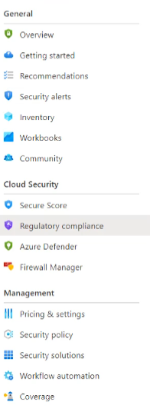
Azure Security Center
Free of Charge
Monitoring service for On Premises and in the Cloud
Log Analytics Agents for Windows and Linux
It is for VMs as well as PAAS systems
Notes:
TODO

Slide 18






Cloud Security
Cloud Security is a top priority at Microsoft
Microsoft invests more than USD 1 billion annually on cybersecurity research and development.
Microsoft employs more than 3,500 security experts who are dedicated to data security and privacy.
Azure has more certifications than any other cloud provider.
Notes:
https://docs.microsoft.com/en-us/compliance/regulatory/offering-home?view=o365-worldwide

Slide 19
Community Repository
Available on GitHub as a valuable resource fore the community
Security recommendations that are in private preview
Programmatic remediation tools for security recommendations
PowerShell scripts for programmatic management
Azure Policy custom definitions for at-scale management of Azure Security Center
Logic App templates that work with Security Center's Logic App connectors (to automate response to Security alerts and recommendations)
Logic App templates that help you run regular tasks or reports within the scope of Azure Security Center
Custom workbooks to visualize Azure Security Center data
Notes:
https://github.com/Azure/Azure-Security-Center

Slide 20
Azure Defender

Slide 21
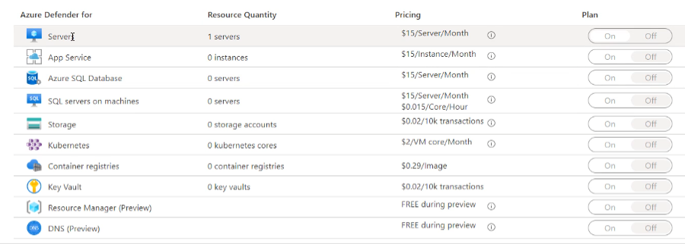
Azure Defender
Paid option
VM Vulnerability Assessment
Just in Time VM Access
Adaptive Application Control
Container Image Scanning
Adaptive Network Hardening
SQL Vulnerability Assessment
File Integrity Monitoring
Network Mapping
IoT Security

Slide 22
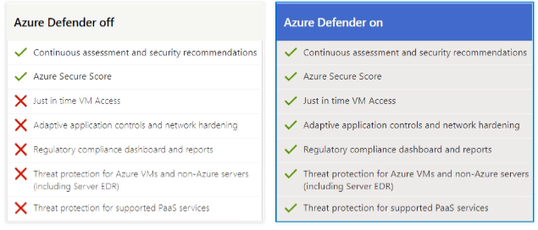
Azure Defender

Slide 23
CSPM Philosophy
Cloud Security Posture Management
Considering Zero Trust Security Model
Considering App Risk Scores
Considering TVM (Threat & Vulnerability Management) for totality of the entire attack Service
Considering the Threat Model Tool

Slide 24
The Concept of SIEM, SOAR and XDR
SIEMs are used for real-time security event analysis to help with investigation, early threat detection and incident response. They also support compliance use cases, as many data regulatory frameworks require organizations to keep audit logs for up to one year.
The key capabilities of SOAR solutions include threat management (help mitigate vulnerabilities), incident response (managing and coordinating response to a security incident) and security operations automation (overall orchestration of workflows, policy execution and reporting).
XDRs centralize normalized data, mostly focusing on products from their own ecosystem. They provide correlated data and alerts into security incidents, and they provide an incident response functionality that can be carried out via security policies.

Slide 25
Log Analytics

Slide 26
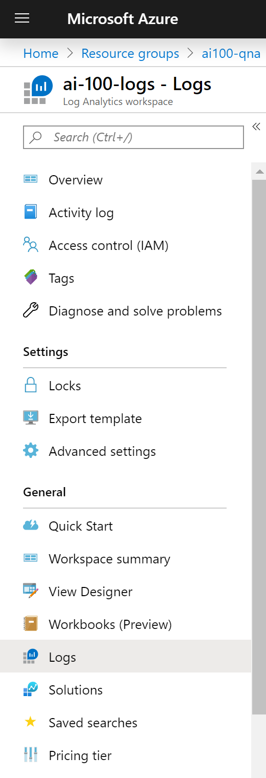
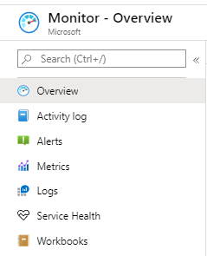
Log Analytics Workspace
The Azure resource used to collect logging data
Linked Azure resources will make corresponding Logs available via blade menu
Logs are queried based on Kusto Query Language (KQL)
Provides limited Visual Designer for building queries
Notes:
Log Analytics is a tool in the Azure portal to edit and run log queries from data collected by Azure Monitor Logs and interactively analyze their results. You can use Log Analytics queries to retrieve records matching particular criteria, identify trends, analyze patterns, and provide a variety of insights into your data.
It can be considered as the basic management unit of Azure Monitor Logs. It is used to collect data from various sources such as Azure Virtual Machines, Windows or Linux Virtual Machines, Azure Resources in a subscription, etc. You may have different resources under different subscriptions and various Azure Monitors to monitor them. An Azure Log Analytics Workspace is a logical storage unit in Azure where all log data generated by Azure Monitors are stored. Azure Log Analytics Workspace makes it easier for us to manage the log data that is collected from various data sources like Azure Virtual Machines.

Slide 27
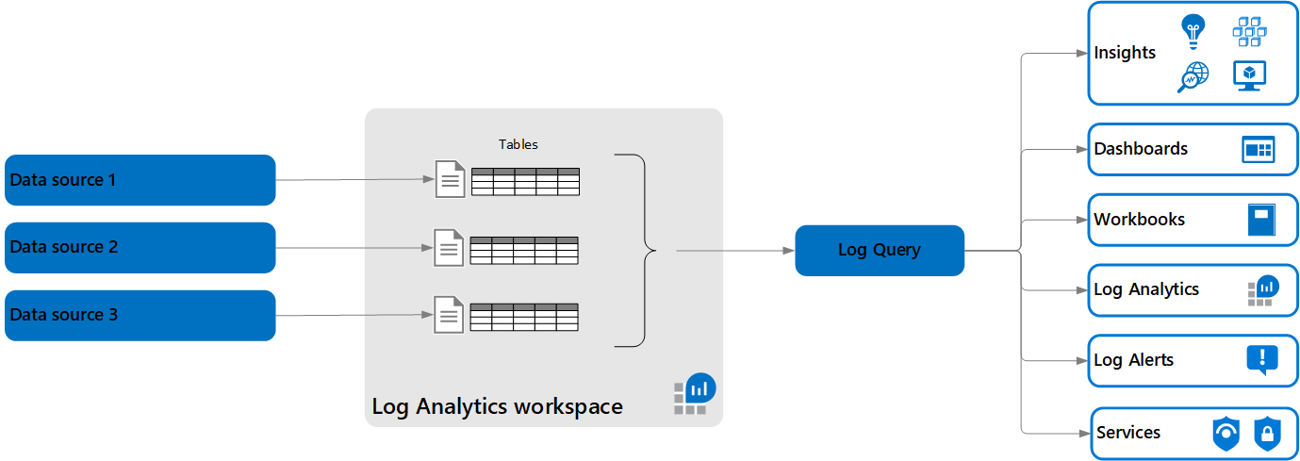
Log Analytics – Architecture
Log queries retrieve their data from a Log Analytics workspace.
Each workspace contains multiple tables are that are organized into separate columns with multiple rows of data. Each table is defined by a unique set of columns that are shared by the rows of data provided by the data source.
Notes:
https://docs.microsoft.com/en-us/azure/azure-monitor/logs/data-platform-logs

Slide 28
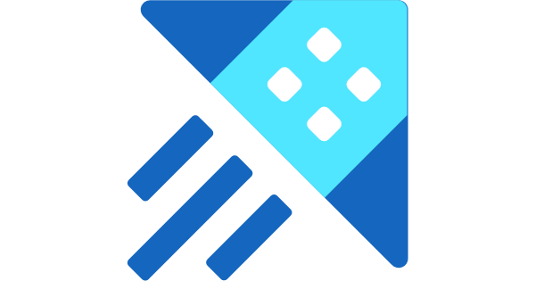
Azure Data Explorer
Azure Data Explorer is a fast, fully managed data analytics service for real-time analysis on large volumes of data streaming from applications, websites, IoT devices, and more.
You can use Azure Data Explorer to collect, store, and analyze diverse data to improve products, enhance customer experiences, monitor devices, and boost operations.
A Log Analytics workspace is roughly the equivalent of a database in Azure Data Explorer, tables are structured the same, and both use the same Kusto Query Language (KQL).
The experience of using Log Analytics to work with Azure Monitor queries in the Azure portal is similar to the experience using the Azure Data Explorer Web UI.
Notes:
The ? Mark is the knowledge center

Slide 29
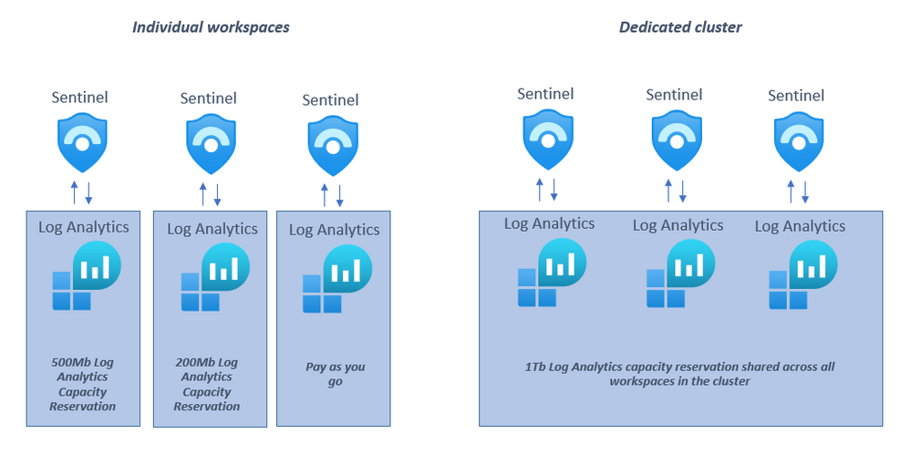
Log Analytics – Dedicated Cluster
Log Analytics dedicated clusters are available for production deployment (registration is required to ensure capacity), supporting high scale and advanced scenarios such as data encryption at rest with Customer-Managed Keys (CMK) and Lockbox.
These dedicated clusters are collections of workspaces rolled into a single managed cluster, which can be used to better handle large scale deployments.
Clusters will only contain workspaces that you select, enabling you to also benefit from cluster-level capacity reservation (starting at 1000GB/day) with discounted pricing.
Notes:
The ? Mark is the knowledge center

Slide 30
Log Analytics – Dedicated Cluster Features
Data Encryption at Rest: Azure Monitor ensures that all data and saved queries are encrypted at rest using Microsoft-managed keys (MMK). Azure Monitor also provides an option for encryption using your own key that is stored in your Azure Key Vault and accessed by storage using system-assigned managed identity authentication. This key (CMK) can be either software or hardware-HSM protected and is available only for dedicated clusters.
LockBox: Lockbox is provided on the Log Analytics dedicated cluster where data is kept in storage accounts under your Lockbox protected subscription. Lockbox gives you control, allowing you to approve or reject Microsoft engineer request to access your data during a support request.
Rate limit: You can have higher ingestion rate limits only on dedicated cluster.
Consistency: You have your own dedicated resources and so there is consistency in terms of performance and latency.
Speed: Cross-workspace queries run faster if all workspaces are on the same cluster.
Notes:
https://docs.microsoft.com/en-us/azure/azure-monitor/logs/logs-dedicated-clusters
https://azure.microsoft.com/en-us/updates/dedicated-clusters-for-azure-monitor-log-analytics-with-cmk-lockbox/
https://techcommunity.microsoft.com/t5/azure-sentinel/what-s-new-dedicated-clusters-for-azure-sentinel/ba-p/2072539

Slide 31
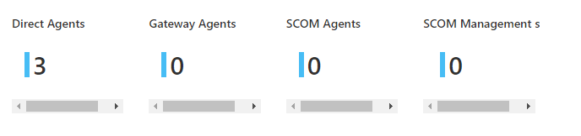
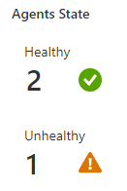
Agents, agents and more agents
Microsoft Monitoring Agent
Direct and Gateway
System Center Operations Manager Agent
TODO

Slide 32
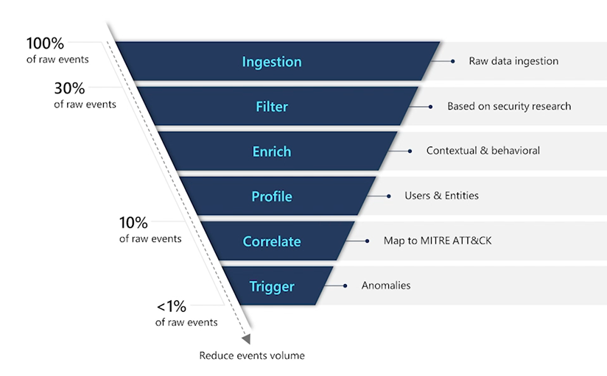
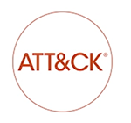
Focus on what’s important
Notes:
The ? Mark is the knowledge center

Slide 33
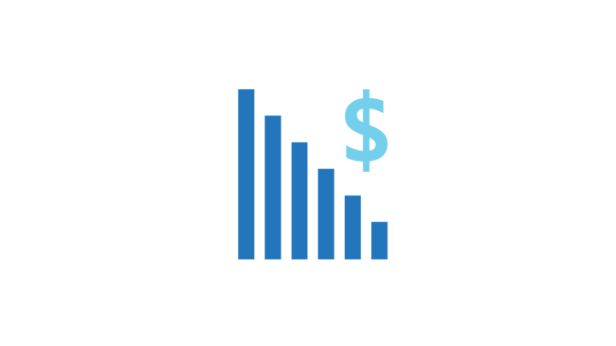
Pricing / Estimating / ADX
There are two ways to pay for ingesting data into Log Analytics:
Capacity Reservations and Pay-As-You-Go.
More than just ingestion that must be considered.
Retention
Alert Rules
Notifications

Slide 34
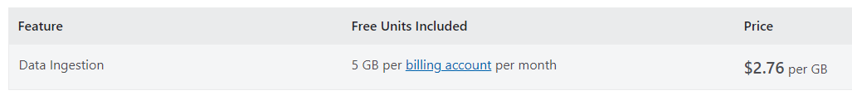
Pay-As-You-Go
With Pay-As-You-Go pricing, you are billed per gigabyte (GB) of data ingested into the Log Analytics workspace.
Notes:
The ? Mark is the knowledge center

Slide 35
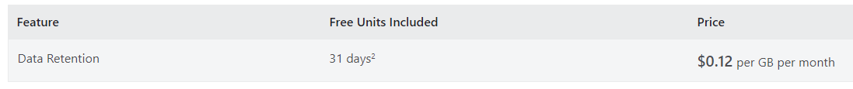
Retention
Every GB of data ingested into your Azure Monitor Log Analytics workspace can be retained at no charge for up to first 31 days.
For Azure Sentinel enabled workspaces the data is retained for free for 90 days.

Slide 36
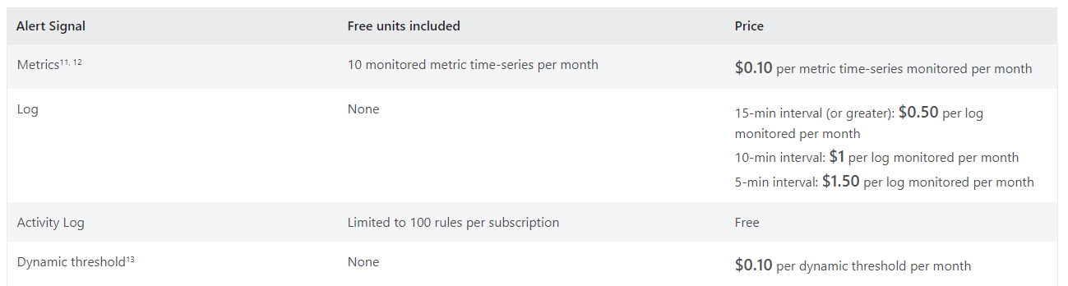
Alert Rules
An alert rule is charged based on the type and number of signals it monitors. A signal can be a resource metric, a log or an activity log. The cost of an alert rule that monitors multiple signals is the sum of the cost of monitoring each signal and any enabled features.

Slide 37
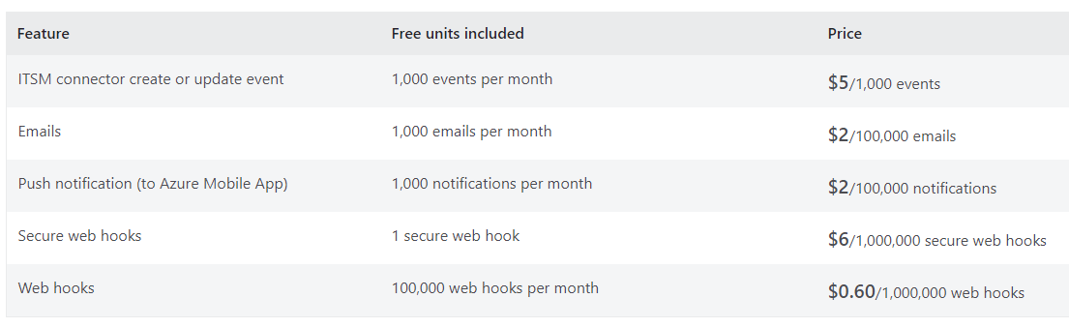
Notifications
Notifications are sent based on when an Alert rule triggers. You are billed based on the type and number of notifications you choose to send.

Slide 38
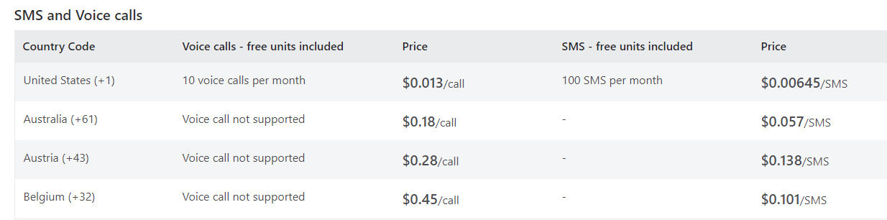
Notifications (SMS and Voice)
Notifications are sent based on when an Alert rule triggers. SMS and Voice charges vary by country.

Slide 39
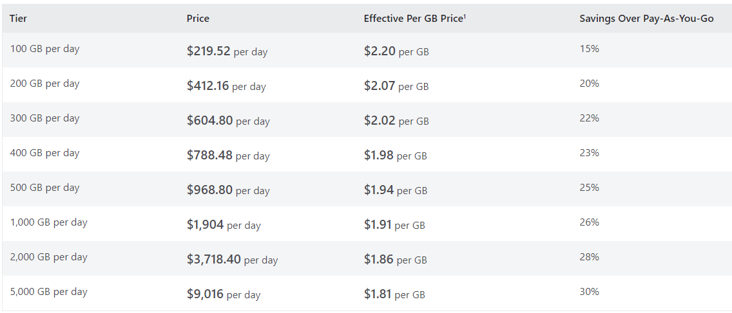
Commitment Tiers
With Commitment tiers you are billed a fixed predictable fee based on your selected commitment tier. Commitment tiers provide you a discount on data ingestion based on your selected commitment tier compared to Pay-As-You-Go pricing.
Notes:
The ? Mark is the knowledge center

Slide 40
Solutions
Log Analytics solutions are a collection of logic, visualization and data acquisition rules that provide metrics pivoted around a particular problem area.
Microsoft’s monitoring solution was System Center Operations Manager (SCOM). It is an agent-based monitoring solution.
SCOM relies on “management packs”. Management packs supply the logic to make it possible to monitor services, applications, infrastructure, and more.
Think of a Log Analytics workspace as a SCOM management group which is freshly installed.

Slide 41
Types of Solutions
Examples of Log Analytics solutions:
Active Directory Assessment
Alert Management (without SCOM alerts)
Antimalware
Change Tracking
Security
SQL Assessment
System Updates
You can search for Solutions in the Global Search bar of Azure.

Slide 42
Solution Targeting
When you add a monitoring solution to your subscription, it's automatically deployed by default to all Windows and Linux agents connected to your Log Analytics workspace.
You may want to manage your costs and limit the amount of data collected for a solution by limiting it to a particular set of agents.
You specify the computers that you want to include in a scope by creating a computer group.
The computer group can be based on a log query or imported from other sources such as Active Directory or WSUS groups.
Only computers that are directly connected to the workspace will be included in the scope.
Once you have a scope configuration, then you can apply it to one or more solutions.
Note that while a single scope configuration can be used with multiple solutions, each solution can only use one scope configuration.

Slide 43
Solutions + Cost
The majority of the Solutions available are free to deploy.
Keep in mind that they all increase the amount of data you’re ingesting into your Log Analytics workspace.
The more data you collect the higher the cost of using Log Analytics.

Slide 44
30, 90 days, oh my.

Slide 45
Retention
Default Log Analytics retention is 30 days.
Add Azure Sentinel, it expands to 90 days.
You have 90 days to resolve your alerts and incidents, if you go past this you risk losing information on the incident.
What do you do?

Slide 46
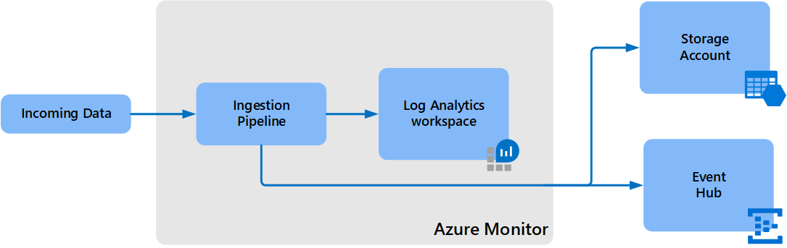
Export
Log Analytics workspace data export in Azure Monitor allows you to continuously export data from selected tables in your Log Analytics workspace to an Azure storage account or Azure Event Hubs as it's collected.
All data from included tables is exported without a filter. For example, when you configure a data export rule for SecurityEvent table, all data sent to the SecurityEvent table is exported starting from the configuration time.

Slide 47
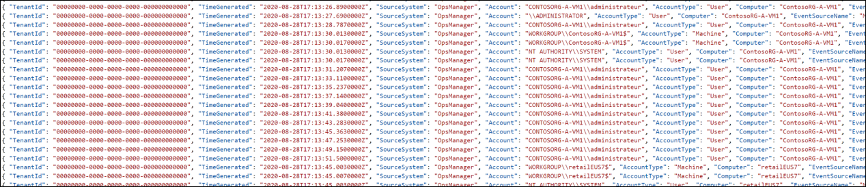
Export – Targets
Storage Account - Data is sent to storage accounts as it reaches Azure Monitor and stored in hourly append blobs. The data export configuration creates a container for each table in the storage account with the name am- followed by the name of the table. For example, the table SecurityEvent would sent to a container named am-SecurityEvent.
Event Hub - Data is sent to your event hub in near-real-time as it reaches Azure Monitor. An event hub is created for each data type that you export with the name am- followed by the name of the table. For example, the table SecurityEvent would sent to an event hub named am-SecurityEvent. If you want the exported data to reach a specific event hub, or if you have a table with a name that exceeds the 47 character limit, you can provide your own event hub name and export all data for defined tables to it.

Slide 48
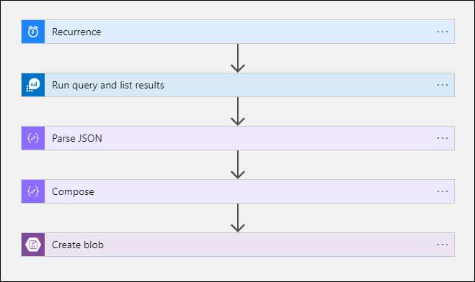
Export – Logic App
This procedure uses the Azure Monitor Logs connector which allows you to run a log query from a logic app and use its output in other actions in the workflow.
The Azure Blob Storage connector is used in this procedure to send the query output to Azure storage.

Slide 49
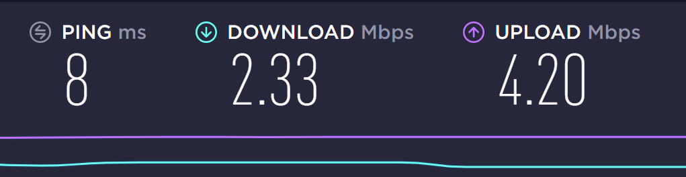
Connector Limits
Log Analytics workspace and log queries in Azure Monitor are multitenancy services that include limits that protect and isolate customers and maintain quality of service.
When querying for a large amount of data, you should consider the following limits, which can affect how you configure the Logic App recurrence and your log query:
Log queries cannot return more than 500,000 rows.
Log queries cannot return more than 64,000,000 bytes.
Log queries cannot run longer than 10 minutes by default.
Log Analytics connector is limited to 100 call per minute.

Slide 50

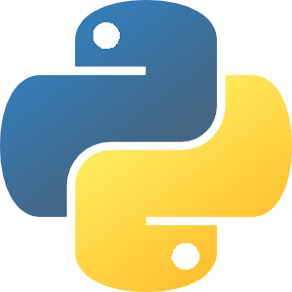

Data Lake + Python + Machine Learning
Once data has been exported to a Storage Account / Data Lake, it can be consumed by Notebooks.
Notebooks can execute advanced Machine Learning against the data.
Outcomes can then be sent back to Azure Sentinel as incidents.

Slide 51
Purging and Compliance

Slide 52
Purging
Purge is a highly privileged operation that no app or user in Azure (including even the resource owner) will have permissions to execute without explicitly being granted a role in Azure Resource Manager.
This role is Data Purger and should be cautiously delegated due to the potential for data loss.
In order to manage system resources, purge requests are throttled at 50 requests per hour.
You should batch the execution of purge requests by sending a single command whose predicate includes all user identities that require purging.
You should run the query before executing the purge request to verify that the results are expected.
While we expect the vast majority of purge operations to complete much quicker than our SLA, due to their heavy impact on the data platform used by Log Analytics, the formal SLA for the completion of purge operations is set at 30 days.

Slide 53
Purging – Why?
Log Analytics is a data store where personal data is likely to be found. Application Insights stores its data in a Log Analytics partition.
Log data refers to data sent to a Log Analytics workspace, while application data refers to data collected by Application Insights. If you are using a workspace-based Application Insights resource, the information on log data will apply but if you are using the classic Application Insights resource then the application data applies.
Where possible, stop collection of, obfuscate, anonymize, or otherwise adjust the data being collected to exclude it from being considered "private".
Where not possible, attempt to normalize the data to reduce the impact on the data platform and performance. For example, instead of logging an explicit User ID, create a lookup data that will correlate the username and their details to an internal ID that can then be logged elsewhere. That way, should one of your users ask you to delete their personal information, it is possible that only deleting the row in the lookup table corresponding to the user will be sufficient.
Finally, if private data must be collected, build a process around the purge API path and the existing query API path to meet any obligations you may have around exporting and deleting any private data associated with a user.

Slide 54
Purging – What?
IP addresses: Log Analytics collects a variety of IP information across many different tables.
User IDs: User IDs are found in a large variety of solutions and tables.
Device IDs: Like user IDs, device IDs are sometimes considered "private".
Custom data: Log Analytics allows the collection in a variety of methods: custom logs and custom fields, the HTTP Data Collector API , and custom data collected as part of system event logs.
Solution-captured data: Because the solution mechanism is an open-ended one, we recommend reviewing all tables generated by solutions to ensure compliance.

Slide 55
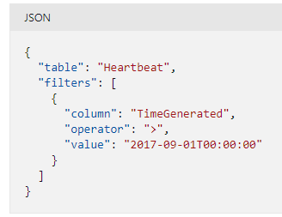
Purging – How?
POST https://management.azure.com/subscriptions/00000000-0000-0000-0000-00000000000/resourceGroups/OIAutoRest5123/providers/Microsoft.OperationalInsights/workspaces/aztest5048/purge?api-version=2020-08-01

Slide 56
Azure Automation Accounts

Slide 57
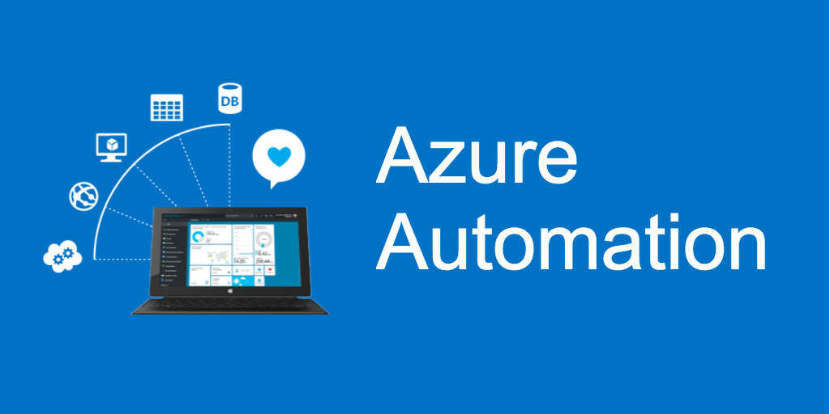
Automation Accounts
Azure Automation delivers a cloud-based automation and configuration service that supports consistent management across your Azure and non-Azure environments.
It comprises process automation, configuration management, update management, shared capabilities, and heterogeneous features.
Automation gives you complete control during deployment, operations, and decommissioning of workloads and resources.
Notes:
The ? Mark is the knowledge center

Slide 58
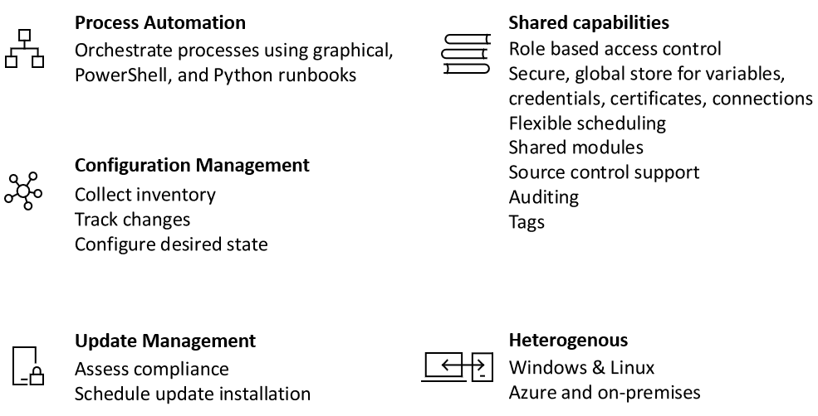
Services
Notes:
The ? Mark is the knowledge center

Slide 59
Process Automation
Process Automation in Azure Automation allows you to automate frequent, time-consuming, and error-prone cloud management tasks.
This service helps you focus on work that adds business value. By reducing errors and boosting efficiency, it also helps to lower your operational costs.
The service allows you to author runbooks graphically, in PowerShell, or using Python.
By using a Hybrid Runbook Worker, you can unify management by orchestrating across on-premises environments.
Webhooks let you fulfill requests and ensure continuous delivery and operations by triggering automation from ITSM, DevOps, and monitoring systems.
Notes:
The ? Mark is the knowledge center

Slide 60
Hybrid Runbook Worker
Runbooks in Azure Automation might not have access to resources in other clouds or in your on-premises environment because they run on the Azure cloud platform.
You can use the Hybrid Runbook Worker feature of Azure Automation to run runbooks directly on the machine that's hosting the role and against resources in the environment to manage those local resources. Runbooks are stored and managed in Azure Automation and then delivered to one or more assigned machines.
The maximum number of Hybrid Worker groups per Automation Account is 4000, and is applicable for both system & user hybrid workers. If you have more than 4,000 machines to manage, we recommend creating another Automation account.
There are two types of Runbook Workers:
System - Supports a set of hidden runbooks used by the Update Management feature that are designed to install user-specified updates on Windows and Linux machines.
User - Supports user-defined runbooks intended to run directly on the Windows and Linux machine that are members of one or more Runbook Worker groups.
Notes:
The ? Mark is the knowledge center

Slide 61
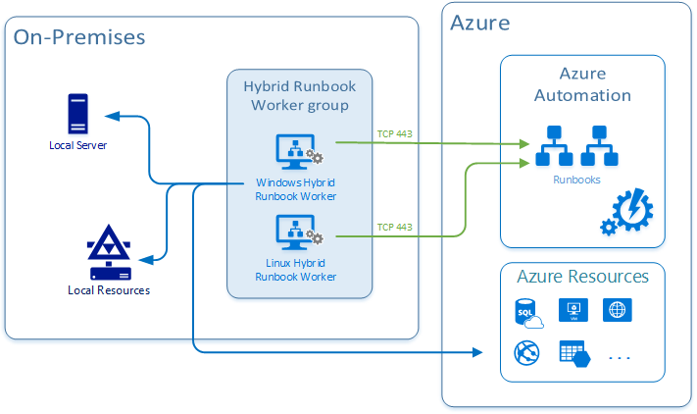
Hybrid Runbook Worker Architecture
When you start a runbook on a user Hybrid Runbook Worker, you specify the group that it runs on. Each worker in the group polls Azure Automation to see if any jobs are available. If a job is available, the first worker to get the job takes it.
Notes:
The ? Mark is the knowledge center

Slide 62
Hybrid Runbook Worker Architecture (Cont)
Hybrid worker works on a polling mechanism (every 30 secs) and follows an order of first-come, first-serve.
Depending on when a job was pushed, whichever hybrid worker pings the Automation service picks up the job.
A single hybrid worker can generally pick up four jobs per ping (that is, every 30 seconds).
If your rate of pushing jobs is higher than four per 30 seconds, then there is a high possibility another hybrid worker in the Hybrid Runbook Worker group picked up the job.
To control the distribution of runbooks on Hybrid Runbook Workers and when or how the jobs are triggered, you can register the hybrid worker against different Hybrid Runbook Worker groups within your Automation account.
Target the jobs against the specific group or groups in order to support your execution arrangement.

Slide 63
Configuration Management
Configuration Management in Azure Automation allows access to two features:
Change Tracking and Inventory
Azure Automation State Configuration
Change Tracking and Inventory combines change tracking and inventory functions to allow you to track virtual machine and server infrastructure changes. The service supports change tracking across services, daemons, software, registry, and files.
Azure Automation State Configuration is a cloud-based feature for PowerShell desired state configuration (DSC) that provides services for enterprise environments
Notes:
The ? Mark is the knowledge center

Slide 64
Update Management
Azure Automation includes the Update Management feature for Windows and Linux systems across hybrid environments.
Update Management gives you visibility into update compliance across Azure and other clouds, and on-premises.
The feature allows you to create scheduled deployments that orchestrate the installation of updates within a defined maintenance window.
If an update shouldn't be installed on a machine, you can use Update Management functionality to exclude it from a deployment.
Notes:
The ? Mark is the knowledge center

Slide 65
Shared Capabilities
Azure Automation consists of a set of shared resources that make it easier to automate and configure your environments at scale.
Schedules - Trigger Automation operations at predefined times.
Modules - Manage Azure and other systems. You can import modules into the Automation account for Microsoft, third-party, community, and custom-defined cmdlets and DSC resources.
Modules gallery - Supports native integration with the PowerShell Gallery to let you view runbooks and import them into the Automation account. The gallery allows you to quickly get started integrating and authoring your processes from PowerShell gallery and Microsoft Script Center.
Python 2 packages - Support Python 2 runbooks for your Automation account.
Credentials - Securely store sensitive information that runbooks and configurations can use at runtime.
Connections - Store name-value pairs of common information for connections to systems. The module author defines connections in runbooks and configurations for use at runtime.
Certificates - Define information to be used in authentication and securing of deployed resources when accessed by runbooks or DSC configurations at runtime.
Variables - Hold content that can be used across runbooks and configurations. You can change variable values without having to modify any of the runbooks or configurations that reference them.
Notes:
The ? Mark is the knowledge center

Slide 66
Common Scenarios
Write runbooks - Author PowerShell, PowerShell Workflow, graphical, Python 2, and DSC runbooks in common languages.
Build and deploy resources - Deploy virtual machines across a hybrid environment using runbooks and Azure Resource Manager templates. Integrate into development tools, such as Jenkins and Azure DevOps.
Configure VMs - Assess and configure Windows and Linux machines with configurations for the infrastructure and application.
Share knowledge - Transfer knowledge into the system on how your organization delivers and maintains workloads.
Retrieve inventory - Get a complete inventory of deployed resources for targeting, reporting, and compliance.
Find changes - Identify changes that can cause misconfiguration and improve operational compliance.
Monitor - Isolate machine changes that are causing issues and remediate or escalate them to management systems.
Protect - Quarantine machines if security alerts are raised. Set in-guest requirements.
Govern - Set up Azure RBAC for teams. Recover unused resources.
Notes:
The ? Mark is the knowledge center

Slide 67
Log Analytics + Linking
All monitoring solutions require a Log Analytics workspace to store data collected by the solution and to host its log searches and views. Some solutions also require an Automation account to contain runbooks and related resources.
The workspace and account must meet the following requirements.
Each installation of a solution can only use one Log Analytics workspace and one Automation account. You can install the solution separately into multiple workspaces.
If a solution requires an Automation account, then the Log Analytics workspace and Automation account must be linked to one another. A Log Analytics workspace may only be linked to one Automation account, and an Automation account may only be linked to one Log Analytics workspace.
When you install a solution through Azure Marketplace, you're prompted for a workspace and Automation account. The link between them is created if they aren't already linked.
Notes:
The ? Mark is the knowledge center

Slide 68
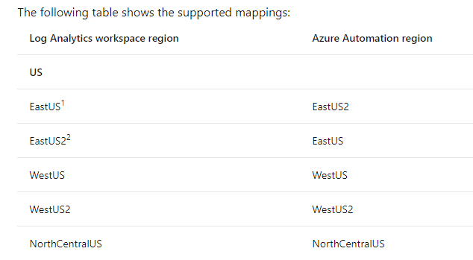
Linking + Regions
In Azure Automation, you can enable the Update Management, Change Tracking and Inventory, and Start/Stop VMs during off-hours features for your servers and virtual machines.
These features have a dependency on a Log Analytics workspace, and therefore require linking the workspace with an Automation account.
However, only certain regions are supported to link them together.
In general, the mapping is not applicable if you plan to link an Automation account to a workspace that won't have these features enabled.
Notes:
https://docs.microsoft.com/en-us/azure/automation/how-to/region-mappings

Slide 69
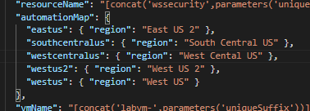
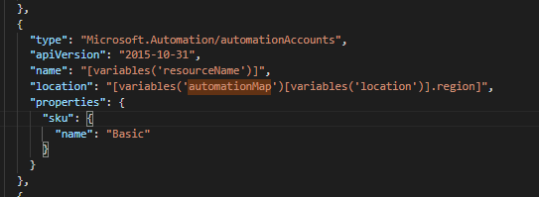
Deploying with ARM
Use mappings via variables and arrays:

Slide 70
Kusto Query Language

Slide 71
Kusto Query Language (KQL)
A Kusto query is a read-only request to process data and return results
The request is stated in plain text, using a data-flow model designed to make the syntax easy to read, author, and automate
The query uses schema entities that are organized in a hierarchy similar to SQL's: databases, tables, and columns
https://docs.microsoft.com/en-us/azure/kusto/query/

Slide 72
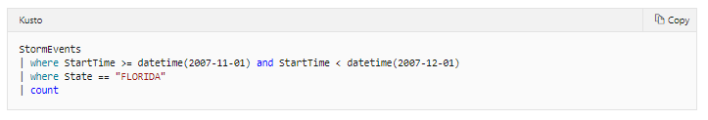
Selecting Data
Start with a reference to a table (StormEvents)
Add a newline starting with a pipe (|) with your where query
Last line will be (|) and the columns you would like returned (count)

Slide 73
KQL – Common Operators
Some useful KQL operators:
where - Filter a table to the subset of rows that satisfy a predicate.
summarize - Produce a table that aggregates the content of the input table.
join - Merge the rows of two tables to form a new table by matching values of the specified column(s) from each table.
count - Return the number of records in the input record set.
top - Return the first N records sorted by the specified columns.
limit - Return up to the specified number of rows.
project - Select the columns to include, rename or drop, and insert new computed columns.
extend - Create calculated columns and append them to the result set.
makeset - Return a dynamic (JSON) array of the set of distinct values that Expr takes in the group
find - Find rows that match a predicate across a set of tables.
Notes:
The ? Mark is the knowledge center

Slide 74
Functions
Functions are reusable queries or query parts
Stored functions, which are user-defined functions that are stored and managed a one kind of a database's schema entities.
Query-defined functions, which are user-defined functions that are defined and used within the scope of a single query. The definition of such functions is done through a let statement.
Built-in functions, which are hard-coded (defined by Kusto and cannot be modified by users).
Notes:
https://docs.microsoft.com/en-us/azure/kusto/query/functions/

Slide 75
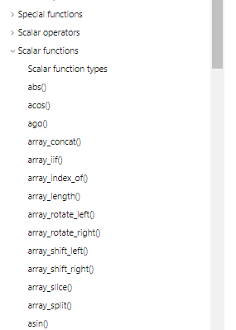
Built-In Functions
Kusto has many pre-defined, built-in functions you can use
Scalar
Aggregation
Window
Time Series Analysis
Machine Learning
Geospatial
Notes:
https://docs.microsoft.com/en-us/azure/azure-monitor/monitor-reference

Slide 76
User-defined Functions
Scalar function
A function with no inputs, or scalar inputs only, and producing a scalar output
Used wherever a scalar expression is allowed.
May only use the row context in which it is defined, and can only refer to tables (and views) that are in the accessible schema.
Tabular function:
A function with no inputs, or at least one tabular input, and producing a tabular output.
Used wherever a tabular expression is allowed.
Notes:
https://docs.microsoft.com/en-us/azure/kusto/query/functions/user-defined-functions

Slide 77
Thank You slide
Break

Slide 78
Welcome Back!
7:00-7:05 | Welcome
7:05-7:15 | Security Center + Azure Defender
7:15-7:45 | Demo Walkthrough
7:45-8:00 | Break
8:00-9:00 | Azure Security Center
9:00-10:00 | Activity: Azure Defender | Table Group Call
10:00-10:15 | Break
10:15-11:00 | Build Hands-on: Azure Defender Part I | Table Group Call
11:00-12:00 | Break | Main Call
12:00-12:30 | Azure Defender Solutions
12:30-13:00 | Activity: Azure Defender | Table Group Call
13:00-14:00 | Build Hands-on: Azure Defender Part 2
14:00-14:15 | Closing | Main Call
Presentation/
Whole Group
Lab
Activity/ Discussion/ Group Work
Announcements

Slide 79
Azure Lighthouse

Slide 80
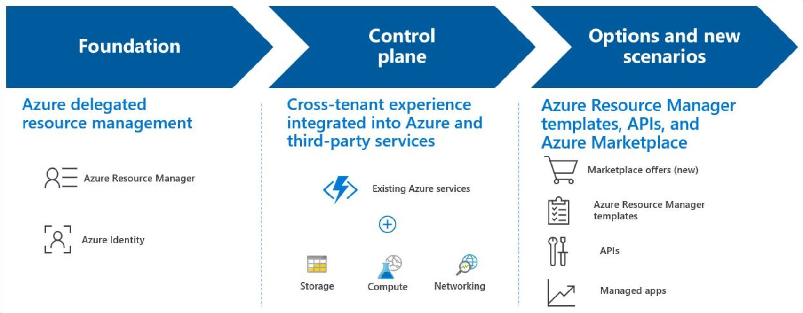
Azure Lighthouse
Azure Lighthouse enables cross- and multi-tenant management, allowing for higher automation, scalability, and enhanced governance across resources and tenants.

Slide 81
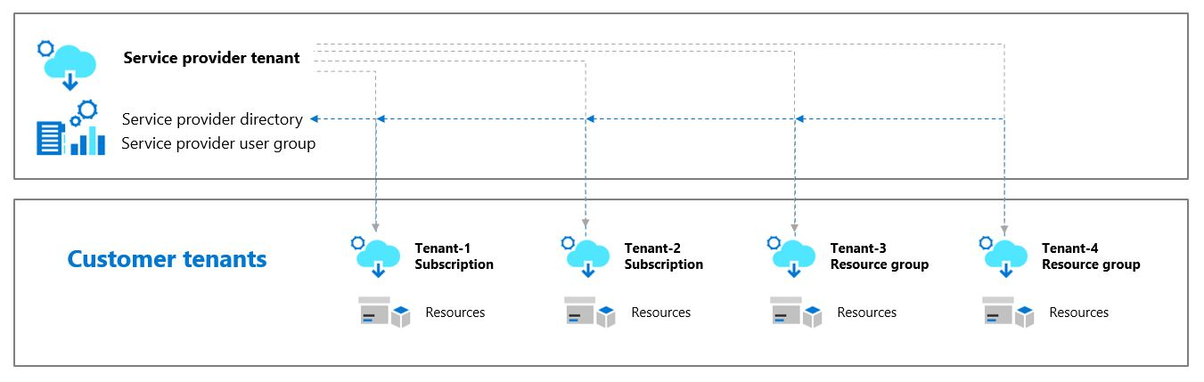
Azure Lighthouse Architecture
Azure Lighthouse helps service providers simplify customer engagement and onboarding experiences, while managing delegated resources at scale with agility and precision.
Authorized users, groups, and service principals can work directly in the context of a customer subscription without having an account in that customer's Azure Active Directory (Azure AD) tenant or being a co-owner of the customer's tenant.

Slide 82
Azure Arc

Slide 83
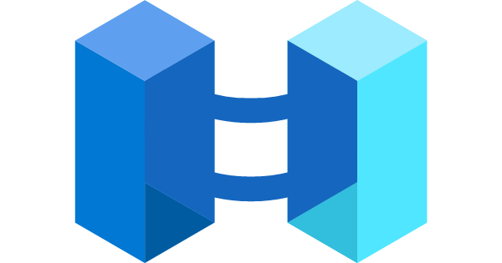
Azure Arc
Azure Arc simplifies governance and management by delivering a consistent multi-cloud and on-premises management platform.
Azure Arc enables you to:
Manage your entire environment, with a single pane of glass, by projecting your existing non-Azure, on-premises, or other-cloud resources into Azure Resource Manager.
Manage virtual machines, Kubernetes clusters, and databases as if they are running in Azure.
Use familiar Azure services and management capabilities, regardless of where they live.
Continue using traditional ITOps, while introducing DevOps practices to support new cloud native patterns in your environment.
Configure Custom Locations as an abstraction layer on top of Azure Arc enabled Kubernetes cluster, cluster connect, and cluster extensions.

Slide 84
Supported Service
Today, Azure Arc allows you to manage the following resource types hosted outside of Azure:
Servers - both physical and virtual machines running Windows or Linux.
Kubernetes clusters - supporting multiple Kubernetes distributions.
Azure data services - Azure SQL Managed Instance and PostgreSQL Hyperscale services.
SQL Server - enroll instances from any location.

Slide 85
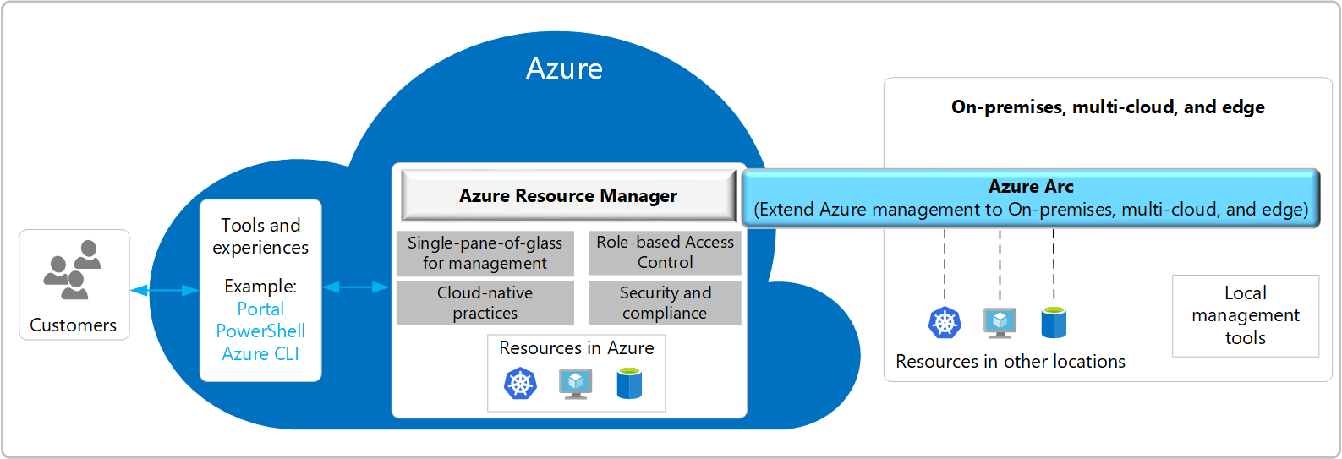
Azure Arc Architecture

Slide 86
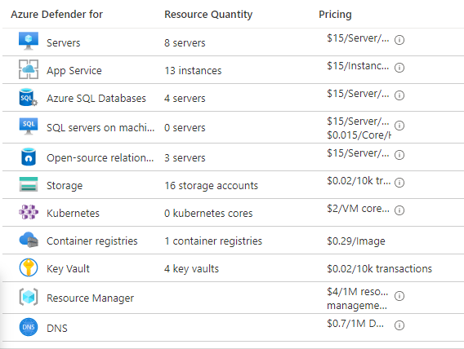
Azure Arc + Azure Security Center
Any Azure service that is used on Arc enabled servers, for example Azure Security Center or Azure Monitor, will be charged as per the pricing for that service.

Slide 87
Azure Defender Solutions

Slide 88

Agenda
1 Azure Defender Solutions
TODO
2 Best Practices
TODO

Slide 89
VM + SQL Vulnerability Assessments

Slide 90
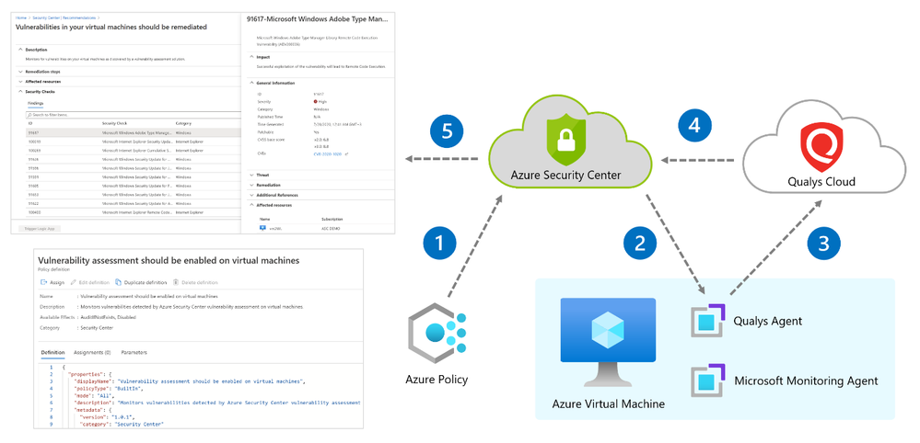
Azure Defender – VM Vulnerability Assessment
Azure Defender includes vulnerability scanning for your machines at no extra cost.
Security Center's integrated vulnerability assessment solution works seamlessly with Azure Arc. When you've deployed Azure Arc, your machines will appear in Security Center and no Log Analytics agent is required.

Slide 91
Qualys Scanner
The vulnerability scanner included with Azure Security Center is powered by Qualys. Qualys' scanner is one of the leading tools for real-time identification of vulnerabilities.
You don't need a Qualys license or even a Qualys account - everything's handled seamlessly inside Security Center.
The Azure Security Center vulnerability assessment extension (powered by Qualys), like other extensions, runs on top of the Azure Virtual Machine agent. Runs as Local Host on Windows, and Root on Linux.
During setup, Security Center checks to ensure that the machine can communicate with the following two Qualys data centers (via port 443 - the default for HTTPS):
64.39.104.113 - Qualys' US data center
154.59.121.74 - Qualys' European data center
Notes:
Qualys Terms:
https://ascva.blob.core.windows.net/vadocs/ASC-Qualys-%20EULA.pdf

Slide 92
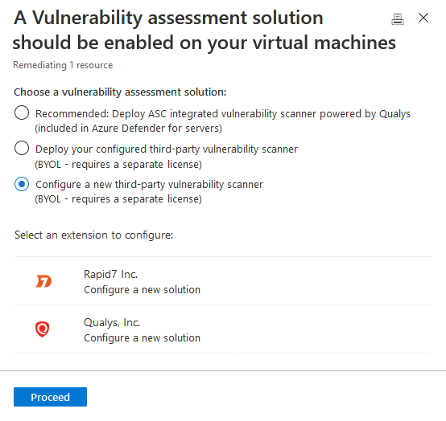
Third-party vulnerability scanners
The BYOL options refer to supported third-party vulnerability assessment solutions. Currently both Qualys and Rapid7 are supported providers.
Supported solutions report vulnerability data to the partner's management platform. In turn, that platform provides vulnerability and health monitoring data back to Security Center.
Notes:
Qualys Terms:
https://ascva.blob.core.windows.net/vadocs/ASC-Qualys-%20EULA.pdf

Slide 93
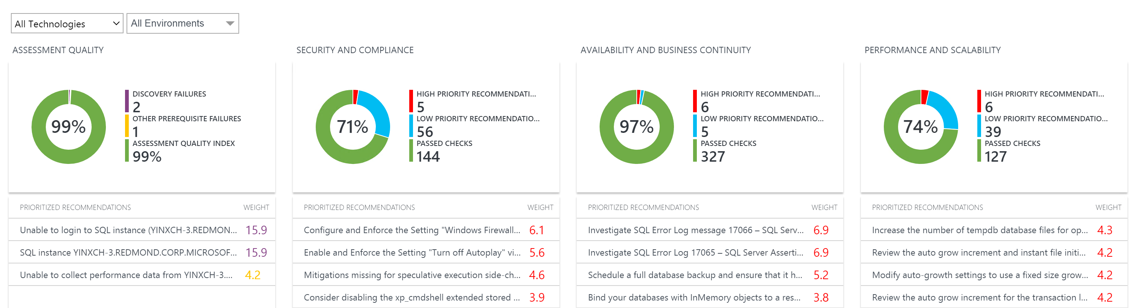
Azure Defender – SQL Vulnerability
SQL vulnerability assessment is an easy-to-configure service that can discover, track, and help you remediate potential database vulnerabilities.
The service employs a knowledge base of rules that flag security vulnerabilities and highlights deviations from best practices, such as misconfigurations, excessive permissions, and unprotected sensitive data.
Assessment Rules cover both database-level issues as well as server-level security issues, like server firewall settings and server-level permissions. These rules also represent many of the requirements from various regulatory bodies to meet their compliance standards.
Notes:
https://docs.microsoft.com/en-us/azure/security-center/deploy-vulnerability-assessment-vm
https://docs.microsoft.com/en-us/azure/azure-sql/database/sql-database-vulnerability-assessment-rules

Slide 94
File Integrity

Slide 95
File Integrity
File integrity monitoring (FIM), also known as change monitoring, examines operating system files, Windows registries, application software, Linux system files, and more, for changes that might indicate an attack.
Security Center recommends entities to monitor with FIM, and you can also define your own FIM policies or entities to monitor.
FIM alerts you for suspicious activity such as:
File and registry key creation or removal
File modifications (changes in file size, access control lists, and hash of the content)
Registry modifications (changes in size, access control lists, type, and the content)

Slide 96
Pop Quiz
Which one of these is NOT a component of a Synapse pipeline?
A) I.R.
B)
Linked Service
C)
Table
D) Activity

Slide 97
Container Image Scanning

Slide 98

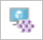
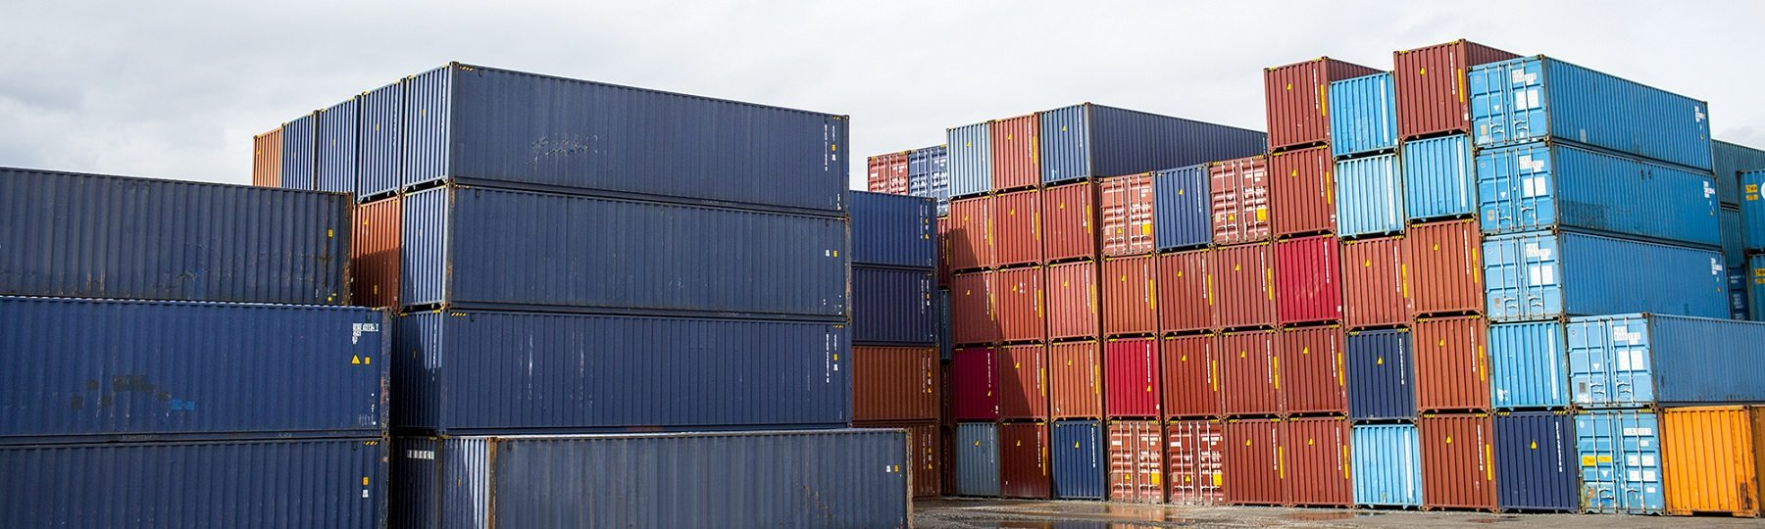
Container Protection
Kubernetes clusters - Continuous assessment of your clusters to provide visibility into misconfigurations and guidelines to help you mitigate identified threats.
Container hosts - Continuous assessment of your Docker environments to provide visibility into misconfigurations and guidelines to help you mitigate threats
Azure Container Registry (ACR) - Vulnerability assessment and management tools for the images in your Azure Resource Manager-based ACR registries

Slide 99
Azure Kubernetes Service
Defends your Kubernetes clusters whether they're hosted in Azure Kubernetes Service (AKS), on-premises, or on other cloud providers. clusters.
Azure Security Center and AKS form a cloud-native Kubernetes security offering with environment hardening, workload protection, and run-time protection
Provides cluster-level threat protection by monitoring your clusters' logs.
Notes:
https://docs.microsoft.com/en-us/azure/security-center/alerts-reference#alerts-k8scluster
https://docs.microsoft.com/en-us/azure/security-center/alerts-reference#alerts-containerhost

Slide 100
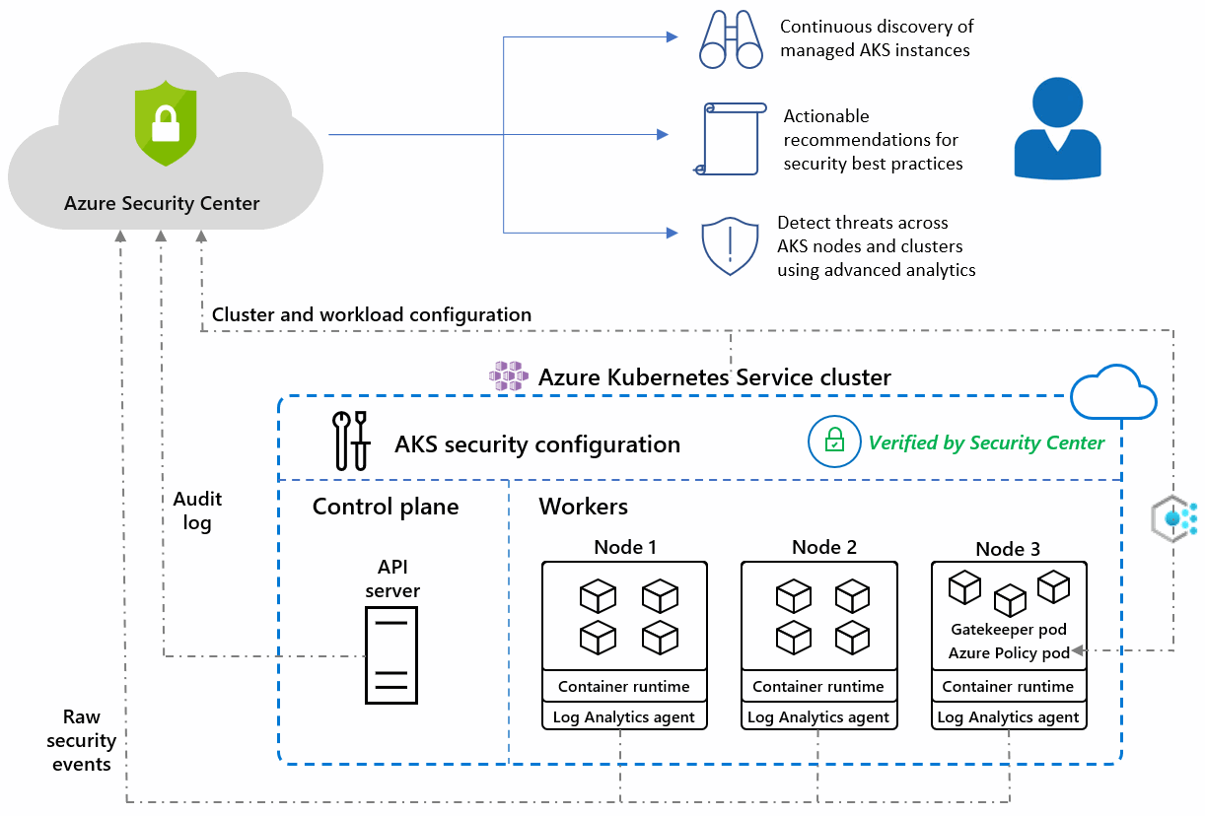
Azure Kubernetes Service
Notes:
https://docs.microsoft.com/en-us/azure/security-center/defender-for-kubernetes-introduction

Slide 101
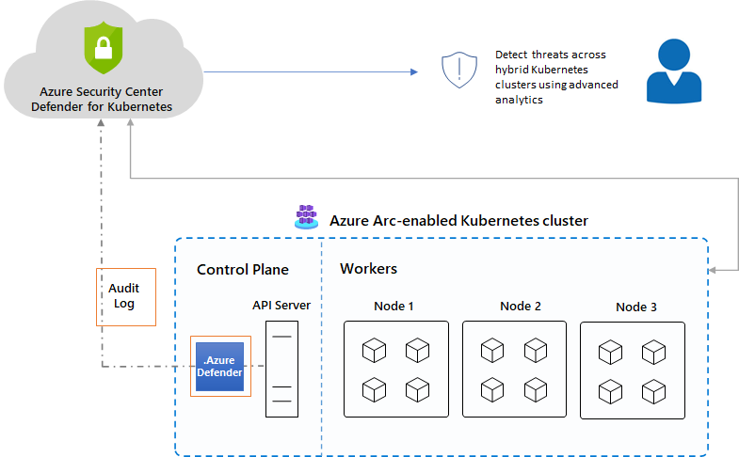
Azure Arc enabled AKS
The Azure Defender for Kubernetes clusters extension can defend your on-premises clusters with the same threat detection capabilities offered for Azure Kubernetes Service clusters.
Notes:
https://docs.microsoft.com/en-us/azure/security-center/defender-for-kubernetes-azure-arc?tabs=k8s-deploy-asc%2Ck8s-verify-asc%2Ck8s-remove-arc

Slide 102
Container Image Scanning
Security Center scans any images pulled within the last 30 days, pushed to your registry, or imported.
The integrated scanner is provided by the industry-leading vulnerability scanning vendor, Qualys.
Findings include related information such as remediation steps, relevant CVEs, CVSS scores, and more.
You can view the identified vulnerabilities for one or more subscriptions, or for a specific registry.
Use the ACR tools to bring images to your registry from Docker Hub or Microsoft Container Registry. When the import completes, the imported images are scanned by Azure Defender.
Notes:
https://docs.microsoft.com/en-us/azure/security-center/defender-for-container-registries-usage

Slide 103
Container Scanning (Docker)
Azure Security Center identifies unmanaged containers hosted on IaaS Linux VMs, or other Linux machines running Docker containers.
When you're exploring the security issues of a VM, Security Center provides additional information about the containers on the machine. Such information includes the Docker version and the number of images running on the host.
Security Center includes the entire ruleset of the CIS Docker Benchmark and alerts you if your containers don't satisfy any of the controls. When it finds misconfigurations, Security Center generates security recommendations.
The CIS benchmark checks don't run on AKS-managed instances or Databricks-managed VMs.

Slide 104
Adaptive Application Control
Notes:
Back to me

Slide 105
Adaptive Application Control
Intelligent and automated solution for defining allow lists of known-safe applications for your machines.
Uses machine learning to analyze the applications running on your machines and create a list of the known-safe software.
By defining lists of known-safe applications, and generating alerts when anything else is executed, you can achieve multiple hardening goals:
Identify potential malware, even any that might be missed by antimalware solutions
Improve compliance with local security policies that dictate the use of only licensed software
Avoid running old or unsupported applications
Prevent specific software that's banned by your organization
Increase oversight of apps that access sensitive data
Notes:
No enforcement options are currently available. Adaptive application controls are intended to provide security alerts if any application runs other than the ones you've defined as safe.

Slide 106
Adaptive Network Hardening
Notes:
Back to me

Slide 107
Adaptive Network Hardening
Adaptive network hardening is an agentless feature of Azure Security Center - nothing needs to be installed on your machines to benefit from this network hardening tool.
Provides recommendations to further harden NSG rules.
It uses a machine learning algorithm that factors in actual traffic, known trusted configuration, threat intelligence, and other indicators of compromise, and then provides recommendations to allow traffic only from specific IP/port tuples.
Adaptive network hardening recommendations are only supported on specific ports.
Notes:
13, 17, 19, 22, 23, 53, 69, 81, 111, 119, 123, 135, 137, 138, 139, 161, 162, 389, 445, 512, 514, 593, 636, 873, 1433, 1434, 1900, 2049, 2301, 2323, 2381, 3268, 3306, 3389, 4333, 5353, 5432, 5555, 5800, 5900, 5900, 5985, 5986, 6379, 6379, 7000, 7001, 7199, 8081, 8089, 8545, 9042, 9160, 9300, 11211, 16379, 26379, 27017, 37215

Slide 108
Just In Time VM Access
Notes:
Back to me

Slide 109
JIT VM Access
Lock down inbound traffic to your Azure Virtual Machines with Azure Security Center's just-in-time (JIT) virtual machine (VM) access feature.
Select the ports on the VM to which inbound traffic will be blocked.
Ensures "deny all inbound traffic" rules exist for your selected ports in the network security group (NSG) and Azure Firewall rules.
When a user requests access to a VM, Security Center checks that the user has Azure role-based access control (Azure RBAC) permissions for that VM.
If the request is approved, Security Center configures the NSGs and Azure Firewall to allow inbound traffic to the selected ports from the relevant IP address (or range), for the amount of time that was specified
After the time has expired, Security Center restores the NSGs to their previous states. Connections that are already established are not interrupted.

Slide 110
Network Map
Notes:
Back to me

Slide 111
Network Map
Provides a graphical view with security overlays giving you recommendations and insights for hardening your network resources.
Using the map you can see the network topology of your Azure workloads, connections between your virtual machines and subnets, and the capability to drill down from the map into specific resources and the recommendations for those resources.
The network map can show you your Azure resources in a Topology view and a Traffic view.
Notes:
The ? Mark is the knowledge center

Slide 112
Topology View
In the inner circle, you can see all the Vnets within your selected subscriptions, the next circle is all the subnets, the outer circle is all the virtual machines.
The lines connecting the resources in the map let you know which resources are associated with each other, and how your Azure network is structured.
If there are too many resources being displayed on the map, Azure Security Center uses its proprietary algorithm to smart cluster your resources, highlighting the resources that are in the most critical state, and have the highest severity recommendations.
Notes:
The ? Mark is the knowledge center

Slide 113
Traffic View
The Traffic view provides you with a map of all the possible traffic between your resources.
This provides you with a visual map of all the rules you configured that define which resources can communicate with whom.
View existing configuration of the network security groups as well as quickly identify possible risky configurations within your workloads.
The strength of this view is in its ability to show you these allowed connections together with the vulnerabilities that exist, so you can use this cross-section of data to perform the necessary hardening on your resources.
For example, you might detect two machines that you weren’t aware could communicate, enabling you to better isolate the workloads and subnets.
Notes:
The ? Mark is the knowledge center

Slide 114
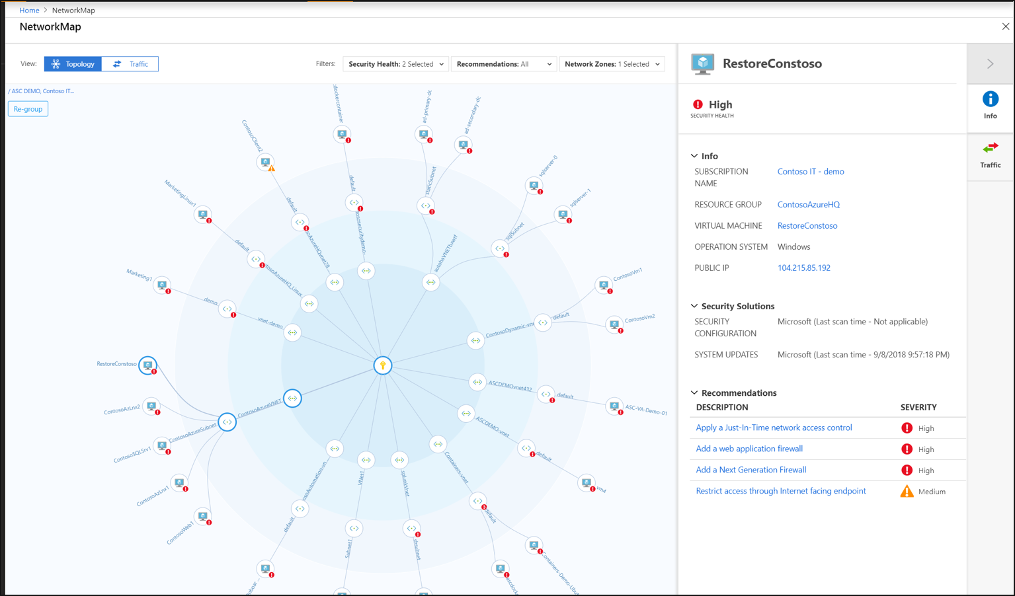
Network Map
Notes:
The ? Mark is the knowledge center

Slide 115
IoT Security
Notes:
Back to me

Slide 116
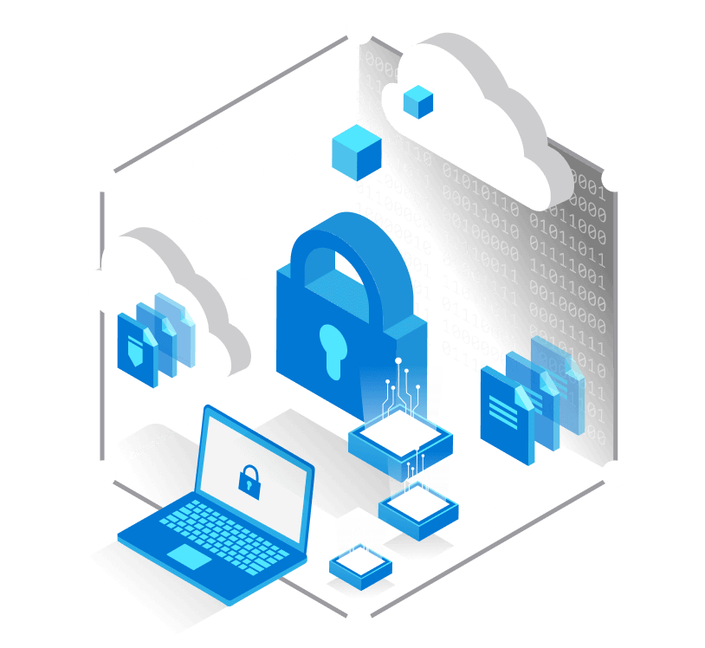
IoT Security
Defender for IoT connects both to the Azure cloud and to on-premises components.
The solution is designed for scalability in large and geographically distributed environments with multiple remote locations.
This solution enables a multi-layered distributed architecture by country, region, business unit, or zone.
Provides both agent and agentless solutions with cloud and offline deployments
Notes:
https://docs.microsoft.com/en-us/azure/defender-for-iot/architecture

Slide 117
Agent-based
TODO
Notes:
The ? Mark is the knowledge center

Slide 118
Agentless-based (IoT Sensors)
The Defender for IoT sensors discover, and continuously monitor network devices.
Sensors collect ICS network traffic using passive (agentless) monitoring on IoT and OT devices.
Purpose-built for IoT and OT networks, the agentless technology delivers deep visibility into IoT and OT risk within minutes of being connected to the network.
It has zero performance impact on the network and network devices due to its non-invasive, Network Traffic Analysis (NTA) approach.
Notes:
The ? Mark is the knowledge center

Slide 119

Offline
Notes:
The ? Mark is the knowledge center

Slide 120
Best Practices

Slide 121


Question…
How many different methods of loading ADLS can you think of?
What about a Synapse SQL Pool?

Slide 122
Best Practices
TODO
Notes:
The ? Mark is the knowledge center

Slide 123
Session and Lab Environment

Slide 124

Login to the portal
Notes:
If they don’t have the emails.
Register link: https://bit.ly/32qwla3
Activation Code: ACTIVATE13799

Slide 125

Sessions for Bootcamp

Slide 126

Search for lab
Search for lab
Click on Know More

Slide 127
Thank You slide
Break

Slide 128
DEMO: How to whiteboard designs

Slide 129
Breakout Activity: Azure Defender
As a result of participating in this activity, you will better be able to configure Azure Defender solutions
OUTCOMES
ACTIVITY
60 minutes
Learning Adviser
Table Group Channel
As a team review WWI requirements provided in student guide
Open the whiteboard and as a team answer the provided challenge questions.
The questions are pre-loaded into the whiteboard.
Welcome | Keynote | Demo Walkthrough | Break | Data Loading & Data Lake Organization | Activity: Data Lake Design & Security Considerations | Break | Lab: Data Integration Part 1 | Break | Data Transformations | Activity: Data Engineering Discussion | Lab: Data Integration Part 2 | Closing

Slide 130
DEMO: How to access your lab environment

Slide 131
Build Hands-on Lab: Azure Defender Part 1
As a result of participating in this lab, you will be better able to deploy azure defender protections
OUTCOMES
ACTIVITY
60 minutes
Independent
Table Group Channel & CloudLabs Environment
Independently review and complete Exercises 1-4 in the Lab 1 Guide.
Login to your CloudLabs environment and work through a set of tasks you would typically follow in work associated with ingesting and integrating your customer’s data.
The Lab Guide is available in the ‘Files’ tab of the General channel. Engage your Table Group call for support and troubleshooting.
Welcome | Keynote | Demo Walkthrough | Break | Data Loading & Data Lake Organization | Activity: Data Lake Design & Security Considerations | Break | Lab: Data Integration Part 1 | Break | Data Transformations | Activity: Data Engineering Discussion | Lab: Data Integration Part 2 | Closing

Slide 132
Welcome Back!
8:00-8:05 | Welcome | Main Call
8:05-8:15 | Security Center + Azure Defender
8:15-8:45 | Demo Walkthrough
8:45-9:00 | Break
9:00-10:00 | Azure Defender File Integrity + Container Image Scanning
10:00-10:15 | Break | Table Group Call
10:15-11:15 | Azure Defender Adaptive Application Control + Adaptive Network Hardening
11:15-12:15 | Build Hands-on: Azure Defender Part 1
12:15-1:15 | Break | Main Call
1:15-2:15 | Azure Defender VM/SQL Vulnerability Assessments | Main Call
2:00-3:00 | Activity: Azure Defender | Table Group Call
3:00-4:00 | Build Hands-on: Azure Defender Part 2
4:00-4:15 | Closing | Main Call
Presentation/
Whole Group
Lab
Activity/ Discussion/ Group Work
Announcements

Slide 133
Thank You slide
Thank you

Slide 134

Full Group Activity: Azure Defender
Objective: As a result of participating in this activity, you will better be able to TODO.
What you will be doing: The facilitator will be posting questions to the entire group using an interactive tool called Mentimeter. The answers you post using Mentimeter will then drive the discussion.
Total Activity Time: 30 minutes

Slide 135

Mentimeter Poll
Scan QR Code
or Go to www.menti.com and use code
1183 9575
Notes:
https://www.menti.com/9r2wwujwag

Slide 136

Hands-On Build Activity: Azure Defender Part 2
Objective: As a result of participating in this lab, you will be better able to TODO.
What you will be doing: Like the Part 1 exercise, you work individually in your lab environment to complete a set of tasks you would typically follow in work associated with ingesting and integrating your customer’s data. A set of tasks are outlined for you to follow and complete.
Total Activity Time: 60 minutes

Slide 137









Lab: individual lab exercise
Step 1: Go to your table group channel
Step 2: Your Learning Adviser will provide you a unique cloud lab login link
Step 3: Login and begin the lab. Engage your table group via a Microsoft Teams “meet now” call to support each other (meet now button in upper right corner of application)

Slide 138
Closing
Thank you for your participation in today’s Azure Synapse Technical Boot Camp!
We learned:
File Integrity
Adaptive Application and Network Hardening
VM and SQL Vulnerability Assessment
Container Instance Monitoring
TODAY
We will learn to:
Azure Sentinel
Azure Sentinel + Azure Defender
TOMORROW

